Slide 1
ENGLISH II
Marisol Negrete Verduzco

Slide 2
Comparatives and superlatives

Slide 3
Adjectives /Adjetivos
The adjectives are part of the sentence or word class that complements a noun to qualify it; expresses characteristics or properties attributed to a noun. For example:
Tall = alto Mary is tall
Short = Bajito Juan is short
Happy = Féliz I am happy
Sad = Triste You are sad
Beautiful = Hermosa She is Beautiful
Difficult = Dificil Math is difficult.
Marisol Negrete Verduzco
Marisol Negrete Verduzco
‹#›

Slide 4
Comparatives/ comparativos
A comparison between two or more, such as: things, animals, plants, people, etc. For example:
Adjective | Comparativ Adjective + er + than (short word) More+ adjective+ than (long word) | Example
Tall | Taller than | Mary is taller than Juan
Short | Shorter than | Juan is shorter than Mary
Happy | Happier than | I am happier than you
Sad | Sadder than | You are sadder than me
Beautiful | More beautiful than | She is more beautiful than you
Difficult | More difficult than | Math is more difficult than Chemistry
Marisol Negrete Verduzco
‹#›

Slide 5
VIDEO COMPARATIVES
Marisol Negrete Verduzco
‹#›

Slide 6
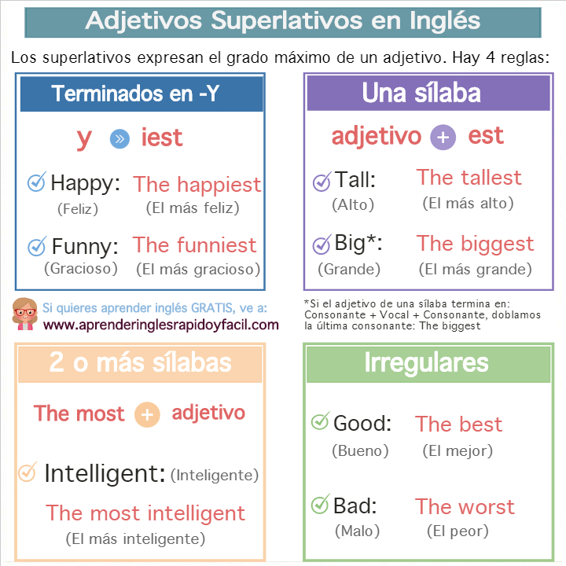
Superlatives/ Superlativos
An adjective in superlative degree, also called comparative of excellence, expresses the characteristic in its maximum degree (Lo mas de todo)
Adjective | Superlative The + Adjective + est (short word) The most+ adjective (long word) | Example
Tall | The Tallest | Mary is the tallest of the class
Short | The Shortest | Juan is the shortest of his family
Happy | The happiest | I am the happiest of the school
Sad | The Saddest | You are the saddest person that I know
Beautiful | The most beautiful | She is the most beautiful girl.
Difficult | The most difficult | Math is the most difficult class.
Marisol Negrete Verduzco
‹#›

Slide 7
VIDEO SUPERLATIVES
Marisol Negrete Verduzco
‹#›

Slide 8
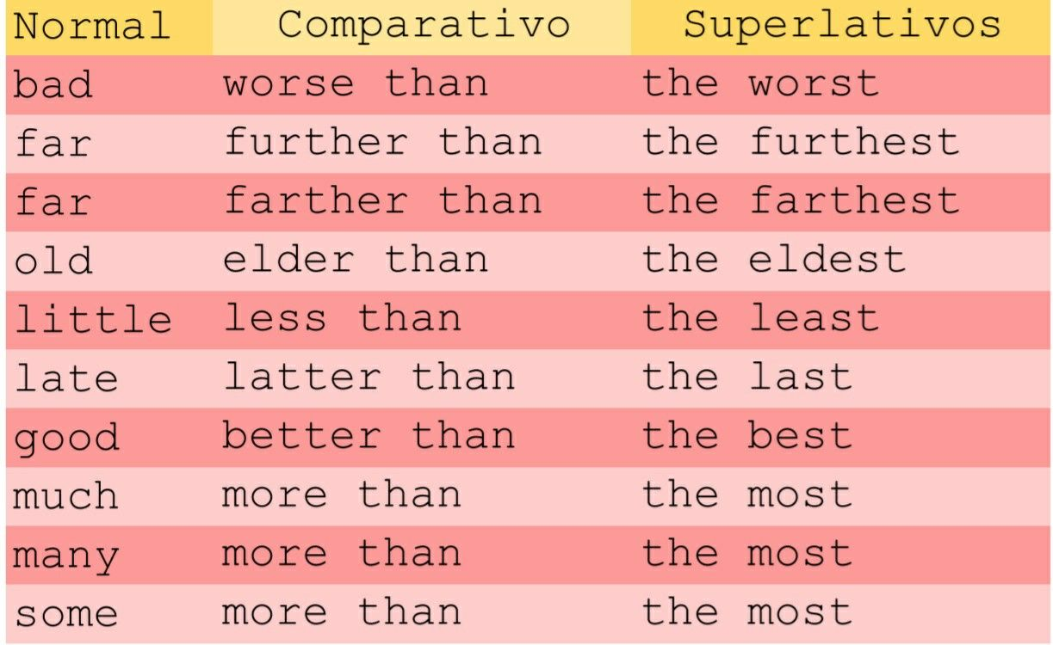
IRREGULARS
Marisol Negrete Verduzco
‹#›

Slide 9
LINKS THE INFORMACION
https://ingles-practico.com/ingles-practico/basico/comparaciones-I.html
https://www.youtube.com/watch?v=M_DixVADeNs&t=21s
https://www.youtube.com/watch?v=OzDp4J5uRDo
Marisol Negrete Verduzco
‹#›

